Slide 1
Continuous Integration

Slide 2
Topics
Continuous Integration
CI Practices
How to Implement CI Practices
Team Responsibilities
Continuous Integration Workflow
Hudson
Jenkins
Top 2 CI Tools

Slide 3
Continuous Integration (CI)
A development practice that requires developers to integrate code into a SCM repository regularly
Teams perform daily builds
Each commit is verified by an automated build
By integrating regularly, teams can
detect errors quickly
locate them more easily
ensure maximum code coverage for integration and regression tests
Notes:
Source: https://www.thoughtworks.com/continuous-integration
SIT –Server Integration Testing

Slide 4
CI Practices
Maintain a single source repository
Automate the build
Make your build self-testing
Every commit should build on an integration machine
Keep the build fast
Test in a clone of the production environment
Make it easy for anyone to get the latest executable
Everyone can see what’s happening
Automate deployment

Slide 5
How to Implement CI Practices
Developers check out code into their private workspaces.
When done, the commit changes to the repository.
The CI server monitors the repository and checks out changes when they occur.
The CI server builds the system and runs unit and integration tests.
The CI server releases deployable artifacts for testing.
The CI server assigns a build label to the version of the code it just built.
The CI server informs the team of the successful build.
If the build or tests fail, the CI server alerts the team.
The team fix the issue at the earliest opportunity.
Continue to continually integrate and test throughout the project.

Slide 6

Team Responsibilities
Check in frequently
Don’t check in broken code
Don’t check in untested code
Don’t check in when the build is broken
Don’t go home after checking in until the system builds
Notes:
Image Source: http://www.exetie.com/uploaded/custom_software_development.jpg

Slide 7
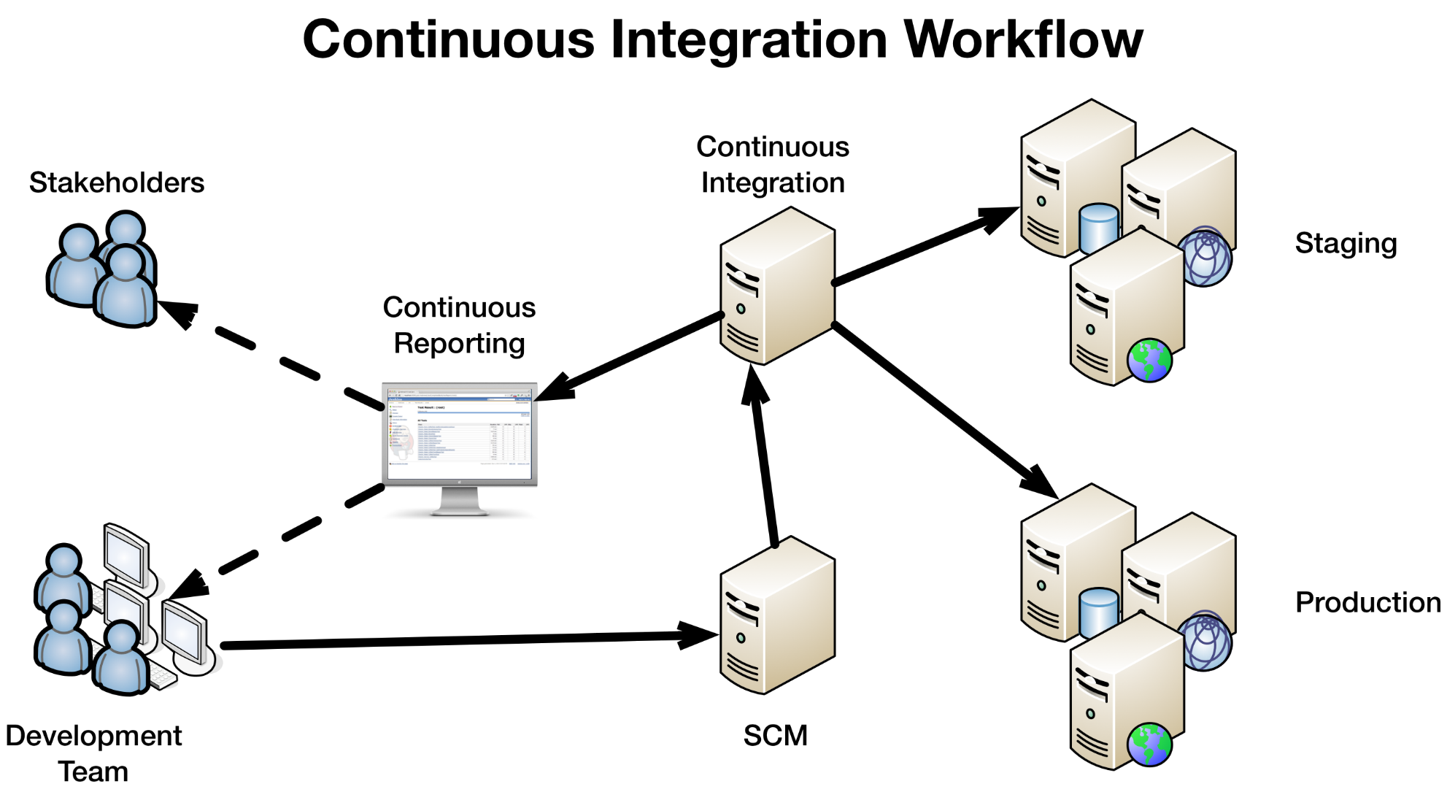

Slide 8

Hudson
Hudson is a continuous integration and continuous delivery application
Developed by Sun Microsystems in 2004
Increases your productivity
Build and test your software projects continuously
Easier for developers to integrate changes to the project
Easier to detect build problems early
Easier for users to obtain a fresh build
Allows continuous delivery your software
define your build pipelines
integrate with testing and deployment technologies

Slide 9

Jenkins
In 2010, project contributors and Oracle disputed control of Hudson
In 2011, Jenkins forked away from Hudson
Jenkins is also a continuous integration and continuous delivery application
Shares the same code base and functionality as Hudson
Jenkins has many more contributors
Releases new functionality faster than Hudson
Used by: Dell, LinkedIn, Facebook, eBay, Github, Netflix, NASA, Sony

Slide 10
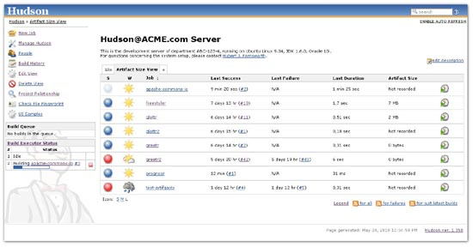
Hudson GUI

Slide 11
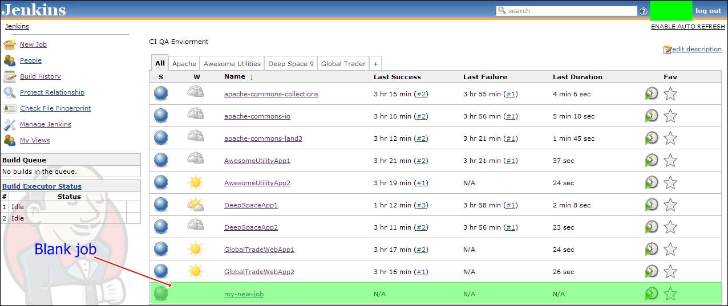
Jenkins GUI

Slide 12

Top 2 CI Tools
Maintained by Oracle
136 commits from 4 contributors
264 issues since 2011
Community developers (including OGs)
307 commits from 30 contributors
79 issues since 2001
More widely adopted
BEAST MODE!

Slide 13
Review
Continuous Integration
CI Practices
How to Implement CI Practices
Team Responsibilities
Continuous Integration Workflow
Hudson
Jenkins
Top 2 CI Tools

